Slide 1
A Call to Covenant: Purify the Church
A Study of D&C 38 - Lesson 3
Elder Gary R. Whiting
Odessa Reunion 2023

Slide 2
D&C 38: A Call to Covenant
Lessons for this week
1. Monday: History and Overview of D&C 38
2. Tuesday: Prepare the church
3. Wednesday: Purify the church
4. Thursday: Preserve the church
5. Friday: Prosper the church

Slide 3
D&C 38: A Call to Covenant
God’s Plan to
Purify the Church

Slide 4
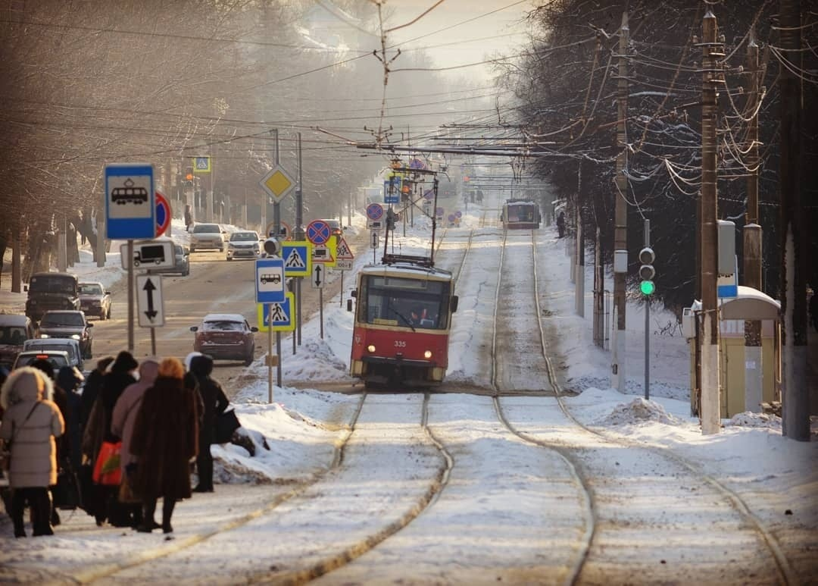

Slide 5
D&C 38: A Call to Covenant
The purification of the Saints and the church is the purpose of Jesus Christ.
This is the process of our redemption and salvation.
Reverses the effects and consequences of the Fall.
All this work is dependent upon the character, attributes and perfections of Jesus Christ.
This highlights the importance of the preamble of this revelation.

Slide 6
D&C 38:1a-e
1a. Thus saith the Lord, your God, even Jesus Christ, the great I AM, Alpha and Omega, the beginning and the end, the same which looked upon the wide expanse of eternity and all the seraphic hosts of heaven before the world was made,
b. the same which knoweth all things, for all things are present before mine eyes. I am the same which spake and the world was made, and all things came by me. I am the same which have taken the Zion of Enoch into mine own bosom,

Slide 7
D&C 38:1a-e
c. and verily, I say, even as many as have believed on my name; for I am Christ, and in mine own name, by virtue of the blood which I have spilt, have I pleaded before the Father for them.
d. but, behold, the residue of the wicked have I kept in chains of darkness until the judgment of the great day, which shall come at the end of the earth;
e. and even so will I cause the wicked to be kept, that will not hear my voice but harden their hearts, and woe, woe, woe is their doom.

Slide 8
D&C 38: A Call to Covenant
Now let’s examine the introduction of the revelation (D&C 38:1)
The Lord your God, even Jesus Christ, the great I AM, the Alpha and Omega, the beginning and the end
I AM the one who spoke all things into being
I AM the one who holds the Zion of Enoch in my bosom

Slide 9
D&C 38: A Call to Covenant
The opening verses are consistent with a covenant statement.
The Great King declares who he is.
Followed by a reference to the other party.
Benefits of the covenant are listed.
The stipulations (laws, requirements, etc.).

Slide 10
D&C 38: A Call to Covenant
How does Jesus introduce himself to us?
The God who speaks (1a).
And God said …
Isaiah 45:19 I haven’t spoken in secret … I speak things that are right
Jesus Christ (1a, c).
This is his name and title
“God will save his people from their sins” (Matthew 2:4).
Christ = Messiah, the chosen and anointed One of Israel

Slide 11
D&C 38: A Call to Covenant
The great I AM (1a).
Exodus 3:13-14 This is the name of God given to Moses.
John records several times Jesus used this name.
Alpha and Omega, the beginning and the end (1a).
Revelation 1:8, 11 – the name Jesus used to identify himself in the Revelation given to John.
Timeless, eternal, infinite

Slide 12
D&C 38: A Call to Covenant
Creator (1a, b).
Existed prior to the creation of the world.
Viewed all eternity
Comprehended the seraphic (angelic) hosts of heaven (Lord Sabaoth)
I spoke and the world was made.
All things came by me (John 1:2-3).

Slide 13
D&C 38: A Call to Covenant
All-knowing [Omniscient] (1b).
Knows all things
Omnipresent (1b).
All things are present before me (see 1a).
God of the Everlasting Covenant (1b).
Zion of Enoch in my bosom.
The God who will return
He is the Lord of Zion

Slide 14
D&C 38: A Call to Covenant
Redeemer (1c).
Savior (1c).
Intercessor (1c).
Advocate with the Father (1c).
D&C 45:1c; D&C 28:2b
The Way, the Truth and the Life (1c).
See John 14:6

Slide 15
D&C 38: A Call to Covenant
Judge (1d-e).
Reserved the wicked for the judgment at the end of the earth.
Saves those who believe in his name.
King
Sets the law
Enforces the law
Romans 13:1-2 IV
Isaiah 33:22 – the Lord is our judge, our lawgiver, our king.

Slide 16
D&C 38:2 a-c
2a. But, behold, verily, verily I say unto you, that mine eyes are upon you:
b. I am in your midst and ye can not see me, but the day soon cometh that ye shall see me and know that I am; for the veil of darkness shall soon be rent, and he that is not purified shall not abide the day: wherefore, gird up your loins and be prepared.
c. Behold, the kingdom is yours and the enemy shall not overcome.

Slide 17
D&C 38: A Call to Covenant
The Lord seeks to purify the church by his immediate presence in “our midst” (2a).
Lesson 2 covered this.
His eyes are upon us.
Not as a spy
As a shepherd watches his flock (see John 10).
To guard us.
To guide us.
To correct us.

Slide 18
D&C 38: A Call to Covenant
The promise of the Second Coming (2b).
Cannot see me, but soon will.
Veil of darkness will be rent (torn).
He brings the voice of warning (2b).
If not purified, cannot/shall not abide the day.
The encourager
The kingdom in yours (2c).
The enemy shall not overcome (2c).

Slide 19
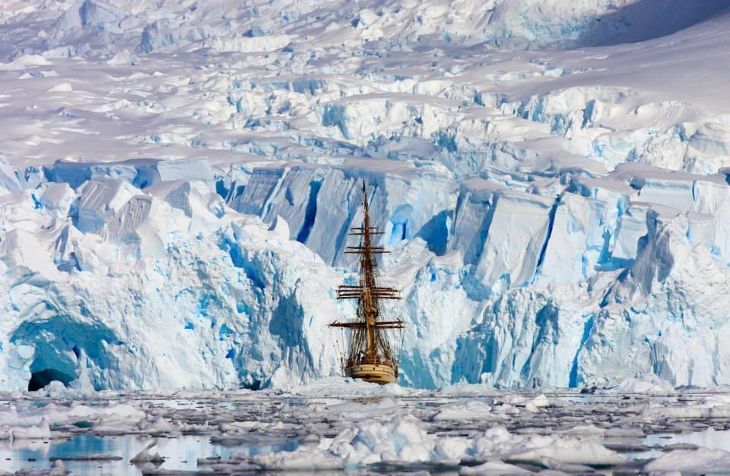

Slide 20
D&C 38:4 a-c
4a. And now I show unto you a mystery, a thing which is had in secret chambers, to bring to pass even your destruction, in process of time, and ye knew it not, but now I tell it unto you,
b. and ye are blessed, not because of your iniquity, neither your hearts of unbelief, for verily some of you are guilty before me; but I will be merciful unto your weakness.
c. Therefore, be ye strong from henceforth; fear not for the kingdom is yours: and for your salvation I give unto you a commandment,

Slide 21
D&C 38: A Call to Covenant
In v. 4a, the Lord shows the result of being overcome with iniquity.
Conspiring to destroy the work of the Lord and his people.
This is the work of secret combinations.
These began with Cain and his brethren’s rebellion (Genesis 5:13-16).

Slide 22
D&C 38: A Call to Covenant
The Lord identifies the state of the church by God’s evaluation.
This evaluation is because “mine eyes are upon you” and “I am in your midst.”
This becomes for us like one of the letters to the churches of the Revelation to John.
You are blessed
God’s presence among us is a blessing: opposite of the Fall
Reconciled to God (2 Corinthians 5).

Slide 23
D&C 38: A Call to Covenant
But there is iniquity and unbelief among you.
Some of you are guilty before me.
But I will be merciful unto your weakness.
It is a call to repentance.
Implies here and states clearly elsewhere, “Go and sin no more.”
Every blessing of God to us is dependent on the conditions of repentance

Slide 24
D&C 38: A Call to Covenant
Some say repentance is a disrespectful and harsh message

Slide 25
D&C 38: A Call to Covenant
Some say repentance is a disrespectful and harsh message
It is the most charitable message of all
It is the warning voice and the invitation to new life
Repentance is following Jesus Christ and walking where he leads
Repentance is yielding our will to the will of the Father.
Repentance is the only way to receive the mercy of God.

Slide 26
Helaman 2:73
And he [Jesus Christ] hath power given unto him from the Father, to redeem them from their sins, because of repentance; therefore he hath sent his angels to declare the tidings of the conditions of repentance, which bringeth unto the power of the Redeemer, unto the salvation of their souls.

Slide 27
Helaman 5:65-67
And ye shall hear my words, for, for this intent I have come up upon the walls of this city, that ye might hear and know of the judgments of God which do await you because of your iniquities, and also that ye might know the conditions of repentance; And also that ye might know of the coming of Jesus Christ, the Son of God, the Father of heaven, and of earth, the Creator of all things, from the beginning; and that ye might know of the signs of his coming, to the intent that ye might believe on his name. And if ye believe on his name, ye will repent of all your sins, that thereby ye may have a remission of them through his merits.

Slide 28
Helaman 5:71-72
But behold, the resurrection of Christ redeemeth mankind, yea, even all mankind, and bringeth them back into the presence of the Lord; Yea, and it bringeth to pass the conditions of repentance, that whosoever repenteth, the same is not hewn down and cast into the fire;

Slide 29
Arthur Oakman
And so, respecting our agency, not condoning our sin, Christ stands before us and shows us in his own body what sin is always doing to us. He gave us a revelation of what the consequences would be if we failed to yield obedience to his gospel. In him, who knew no sin, is the perfect revelation of the consequences of sin, what it really is, how it destroys the sons of God, how it puts them to open shame, and denies them of the hope that they may ever reach their best possibilities (Oakman, Arthur, Saints’ Herald April 2, 1949, pgs 5-8, 19).

Slide 30
D&C 38: A Call to Covenant
Our Lord has covenanted with us to provide us redemption and salvation.
He has guaranteed this by his word, his character.
He has opened the way through the atonement
Life, death, resurrection.
Provided the covenant for our salvation (D&C 85:8).

Slide 31
D&C 38: A Call to Covenant
This is why I said you should go to the Ohio (7a-b).
It was there, in Kirtland, God promised to give them his law (7b).
1. To be gathered a righteous people
2. Without spot or blameless

Slide 32
D&C 85:8
8a. And again, verily I say unto you, that which is governed by law, is also preserved by law, and perfected and sanctified by the same.
8b. That which breaketh a law, and abideth not by law, but seeketh to become a law unto itself, and willeth to abide in sin, and altogether abideth in sin, can not be sanctified by law, neither by mercy, justice, or judgment; therefore, they must remain filthy still.

Slide 33
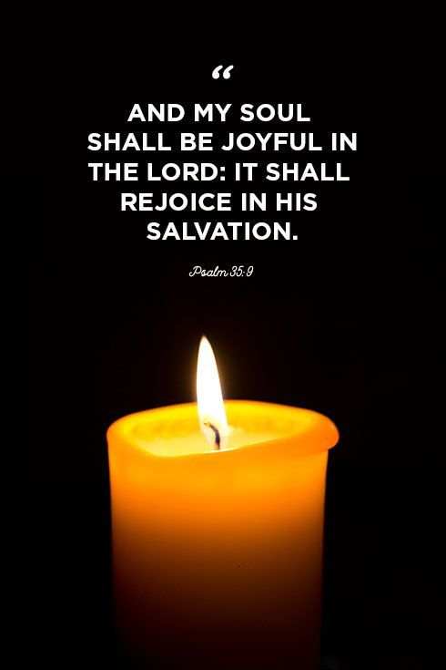

Slide 34
D&C 38: A Call to Covenant
Next lesson: How God Preserves the Church.

