Slide 1
A Call to Covenant: Preserve the Church
A Study of D&C 38 – Lesson 4
Elder Gary R. Whiting
Odessa Reunion 2023

Slide 2
D&C 38: A Call to Covenant
Lessons for this week
1. Monday: History and Overview of D&C 38
2. Tuesday: Prepare the church
3. Wednesday: Purify the church
4. Thursday: Preserve the church
5. Friday: Prosper the church

Slide 3
D&C 38: A Call to Covenant
Prepare us by warning and instruction.
Purify us through the atonement and his character by repentance and teaching us to be obedient.
The Lord has arranged for our preservation.
From what are we preserved?
In what ways are we preserved?

Slide 4
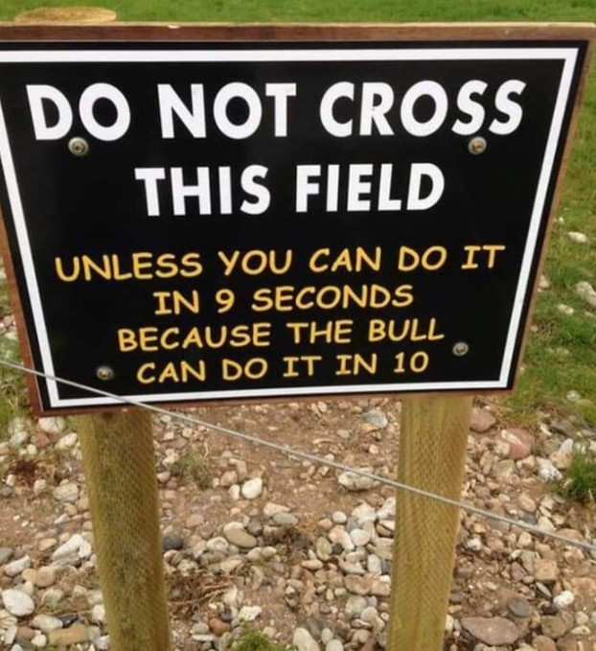

Slide 5
Preserve the Church
How the Lord seeks to Preserve the Church

Slide 6
Genesis 7:68-70
68 And the day shall come that the earth shall rest. But before that day the heavens shall be darkened, and a veil of darkness shall cover the earth; and the heavens shall shake, and also the earth.
69 And great tribulations shall be among the children of men, but my people will I preserve; and righteousness will I send down out of heaven, and truth will I send forth out of the earth, to bear testimony of mine Only Begotten; his resurrection from the dead; yea, and also the resurrection of all men.

Slide 7
Genesis 7:68-70
70 And righteousness and truth will I cause to sweep the earth as with a flood, to gather out mine own elect from the four quarters of the earth, unto a place which I shall prepare; an holy city, that my people may gird up their loins, and be looking forth for the time of my coming; for there shall be my tabernacle, and it shall be called Zion; a New Jerusalem.

Slide 8
D&C 38: A Call to Covenant
The Adversary is at war against Jesus Christ and we are the battleground.
The war has been active since the Garden of Eden.
Eventually, Satan is defeated.
In the meantime, Satan is a clear and present danger to all who are living outside of the covenant protection of the Father through Jesus Christ.

Slide 9
Alma 21:139-142
139 And his heart did glory in it; not in the shedding of blood, but in doing good, in preserving his people; yea, in keeping the commandments of God; yea, and resisting iniquity.
140 Yea, verily, verily I say unto you, if all men had been, and were, and ever would be, like unto Moroni, behold, the very powers of hell would have been shaken for ever; yea, the devil would never have power over the hearts of the children of men.

Slide 10
Alma 21:139-142
141 Behold, he was a man like unto Ammon, the son of Mosiah, yea, and even the other sons of Mosiah; yea, and also Alma and his sons, for they were all men of God.
142 Now behold, Helaman and his brethren were no less serviceable unto the people, than was Moroni; for they did preach the word of God, and they did baptize unto repentance, all men whosoever would harken unto their words.

Slide 11
D&C 38: A Call to Covenant
Joseph Smith had experience in this conflict by this time.
The attack in the Sacred Grove.
The multiple attempts to steal the plates of the Book of Mormon
The lost 116 pages of the Book of Mormon.
Martin Harris and his wife.
The Hiram Page seer stone affair.
Many of the new members may not have been as aware.
Recent success in growth, church organized, BofM pub, etc may have blunted their awareness.

Slide 12
D&C 38: A Call to Covenant
We know for sure, the Lord had specific intentions for the early Restored church.
May not have been as clear to the Saints of that early day.
The Book of Mormon to the Lamanites
Zion as an economic, social and spiritual influence in this country and the world.
Zion as a gathering place.

Slide 13
D&C 38: A Call to Covenant
In this revelation the Lord mentions several threats
1. The powers of darkness which prevail on the earth (3b).
2. The enemy in secret chambers (4a, 6b).
3. The hearts of men in your own land (6c).
4. The power of the enemy—making New York a hazardous place for the young church.

Slide 14
D&C 38: A Call to Covenant
The Lord’s plan for the preservation of the church has three elements
1. Spiritual
Individually and corporately adopt spiritual discipline in Christ.
Some of this we have see in the purify lesson
To permit us to obtain a Celestial reward.

Slide 15
D&C 38: A Call to Covenant
The Lord’s plan for the preservation of the church has three elements
2. Prophetic
For the things to come.
Things related to settling in Missouri
The Civil War
The events in the church
The events of the last days.

Slide 16
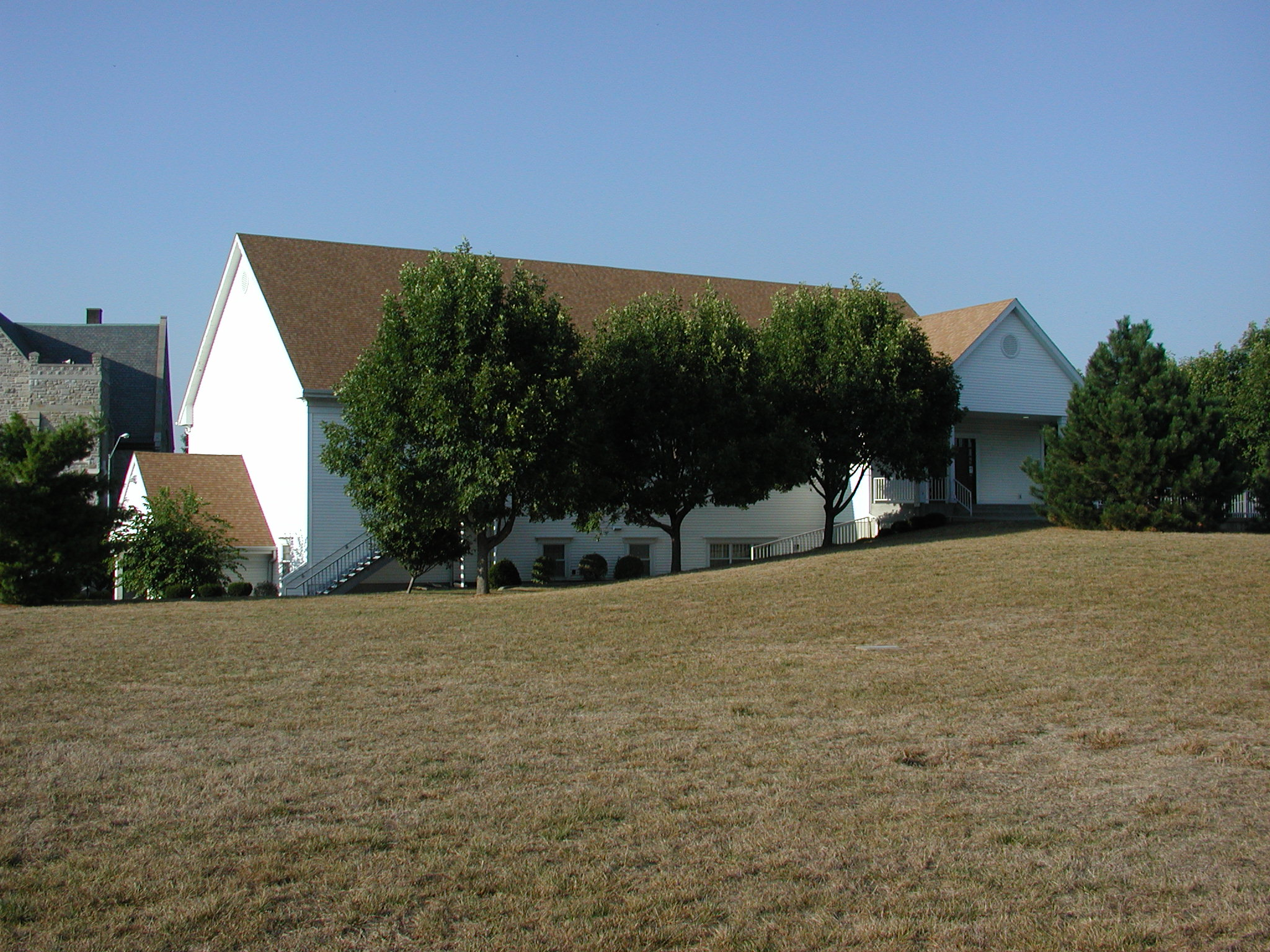
D&C 38:4d-f
4d And I have made the earth rich, and, behold, it is my footstool: wherefore, again I will stand upon it; and I hold forth and deign to give unto you greater riches, even a land of promise; 4e a land flowing with milk and honey, upon which there shall be no curse when the Lord cometh; and I will give it unto you for the land of your inheritance, if you seek it with all your hearts:

Slide 17
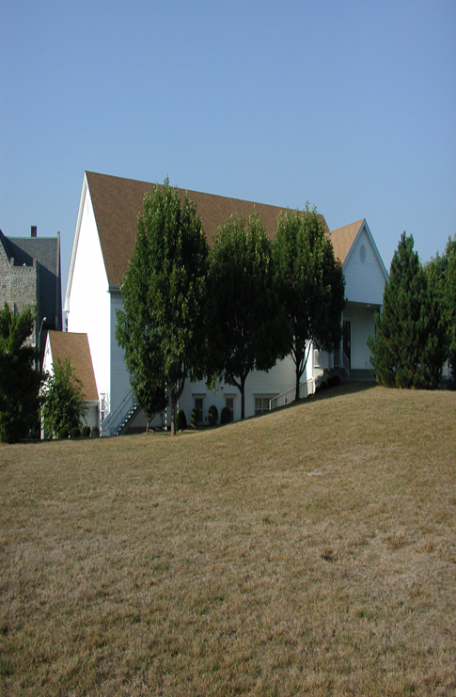
D&C 38:4d-f
4f and this shall be my covenant with you, Ye shall have it for the land of your inheritance, and for the inheritance of your children for ever, while the earth shall stand; and ye shall possess it again in eternity, no more to pass away.

Slide 18
D&C 38: A Call to Covenant
The Lord’s plan for the preservation of the church has three elements
3. Temporal
A land
An inheritance
A place
Prefigures and promises our spiritual and prophetic blessings.

Slide 19
D&C 38: A Call to Covenant
God spoke to the church (us) as he did to Abraham and Moses
A land flowing with milk and honey
Where the law of God will rule
No other ruler but God the Lord
No curse when the Lord comes
To be achieved it must be in the way Abraham, the children of Israel and Lehi obtained their lands
By diligent heed to the word of God (Deuteronomy 8:3, D&C 83:7a-b).
God has called us on an Exodus Journey.

Slide 20
D&C 38: A Call to Covenant
He has offered us Zion, a place of—
Refuge from the tribulations to come.
Learning the way of righteousness and not war.
Power of God to be seen and experienced
Witness to the world
Example to the wicked
A city set on a hill.

Slide 21
D&C 38: A Call to Covenant
The role and power of covenant
Coming under the protective hand of God
How oft will I gather you (3 Nephi 4:58).
To realize the power of covenant with the Father in the name of Jesus Christ.
The power to become the sons of God (John 1:12)
See also D&C 85:8

Slide 22
D&C 85:8
8a And again, verily I say unto you, that which is governed by law, is also preserved by law, and perfected and sanctified by the same.
8b That which breaketh a law, and abideth not by law, but seeketh to become a law unto itself, and willeth to abide in sin, and altogether abideth in sin, can not be sanctified by law, neither by mercy, justice, or judgment; therefore, they must remain filthy still.

Slide 23
Preserve the Church
The Exodus Journey

Slide 24
D&C 38: A Call to Covenant
We are familiar with the exodus of Israel from Egypt.
There is a book of the Bible dedicated to describing it.
Actually 4 books plus part of Genesis.
It was for their preservation from Egyptian rule.
It was to protect them from the corruption of false gods.
It was to allow them to become a holy, sanctified people.
To worship God
Make sacrifices to God
To serve God

Slide 25
D&C 38: A Call to Covenant
To allow the covenants with Abraham, Isaac, Jacob and Joseph to be fulfilled.
To take possession of a land of promise.
This was not the only exodus in scripture.

Slide 26
D&C 38: A Call to Covenant
Enoch to the place of the city of Enoch
Noah to the Ark
Abraham from Ur.
Jared from the Great Tower
Lehi from Jerusalem
Nephi from the Lamanites
King Mosiah I from the Lamanite threat
Alma 1 and the church from King Noah/Lamanites
King Limhi from the Lamanites
Anti-Nephi-Lehites from other Lamanites

Slide 27
D&C 38:4d-f
4d And I have made the earth rich, and, behold, it is my footstool: wherefore, again I will stand upon it; and I hold forth and deign to give unto you greater riches, even a land of promise; 4e a land flowing with milk and honey, upon which there shall be no curse when the Lord cometh; and I will give it unto you for the land of your inheritance, if you seek it with all your hearts:

Slide 28
D&C 38:4d-f
4f and this shall be my covenant with you, Ye shall have it for the land of your inheritance, and for the inheritance of your children for ever, while the earth shall stand; and ye shall possess it again in eternity, no more to pass away.

Slide 29
D&C 38: A Call to Covenant
I give you a land of promise (4d).
If you seek it with all your hearts (4d).
That you might escape the power of the enemy (7a).
And gather you as a righteous people, without spot
I commanded you should go to the Ohio
To give you my law (7b).
D&C 42

Slide 30
D&C 38: A Call to Covenant
Covenant is the tool of God
It is the means by which God grants us agency.
It is the means of our relationship with him.
Covenants provide for judgment.
D&C 85:8
For blessing and for punishment.

Slide 31
D&C 38: A Call to Covenant
Highlights the power of God’s word as stipulations of the covenant.
The power to become the sons and daughters of God.
The commandment to flee Babylon.
Say nothing but repentance to this generation.

Slide 32
D&C 108:2b-c
Go ye out from Babylon. Be ye clean that bear the vessels of the Lord. Call your solemn assemblies, and speak often one to another. And let every man call upon the name of the Lord; yea, verily I say unto you again, The time has come when the voice of the Lord is unto you, Go ye out of Babylon; gather ye out from among the nations, from the four winds, from one end of heaven to the other.

Slide 33
D&C 108:4b
And let them who be of Judah, flee unto Jerusalem, unto the mountains of the Lord's house. Go ye out from among the nations, even from Babylon, from the midst of wickedness, which is spiritual Babylon.

Slide 34
D&C 35:2a-b
And now this calling and commandment give I unto you concerning all men, that as many as shall come before my servants Sidney Rigdon and Joseph Smith, Jr., embracing this calling and commandment, shall be ordained and sent forth to preach the everlasting gospel among the nations, crying repentance, saying, Save yourselves from this untoward generation, and come forth out of the fire, hating even the garments spotted with the flesh.

Slide 35
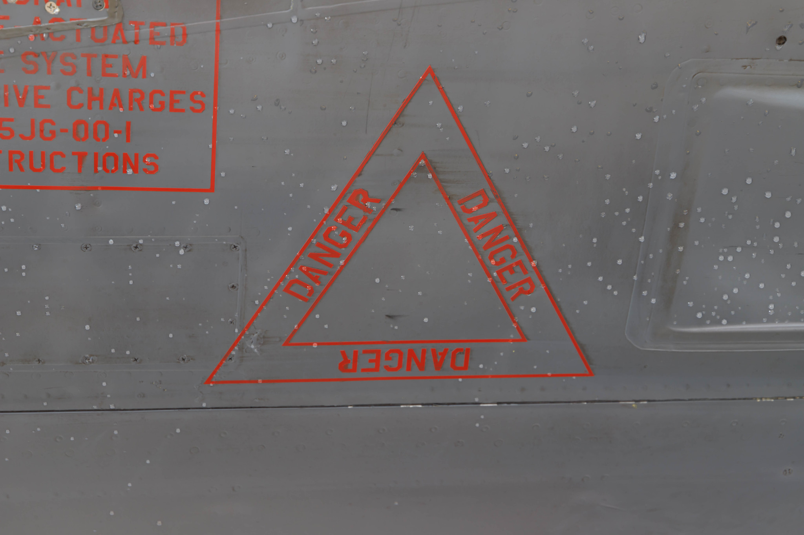

Slide 36
Revelation 18:2-4
… Babylon the great is fallen, is fallen, and is become the habitation of devils, and the hold of every foul spirit, and a cage of every unclean and hateful bird. For all nations have drunk of the wine of the wrath of her fornication, and the kings of the earth have committed fornication with her, and the merchants of the earth are waxed rich through the abundance of her delicacies. And I heard another voice from heaven, saying, Come out of her, my people, that ye be not partakers of her sins, and that ye receive not of her plagues.

Slide 37
Alma 3:98-100
And now I say unto you, all you that are desirous to follow the voice of the good shepherd, come ye out from the wicked, and be ye separate, and touch not their unclean things; And behold, their names shall be blotted out, that the names of the wicked shall not be numbered among the names of the righteous, that the word of God may be fulfilled, which saith, The names of the wicked shall not be mingled with the names of my people. For the names of the righteous shall be written in the book of life; and unto them will I grant an inheritance at my right hand.

Slide 38
D&C 63:13f-h
wherefore, for this cause preached the apostles unto the world the resurrection of the dead: these things are the things that ye must look for, and speaking after the manner of the Lord, they are now nigh at hand; and in a time to come, even in the day of the coming of the Son of Man, and until that hour, there will be foolish virgins among the wise, and at that hour cometh an entire separation of the righteous and the wicked; and in that day will I send mine angels, to pluck out the wicked, and cast them into unquenchable fire.

Slide 39
D&C 1:3a-4a
Wherefore the voice of the Lord is unto the ends of the earth, that all that will hear may hear; prepare ye, prepare ye for that which is to come, for the Lord is nigh; and the anger of the Lord is kindled, and his sword is bathed in heaven, and it shall fall upon the inhabitants of the earth; and the arm of the Lord shall be revealed; and the day cometh that they who will not hear the voice of the Lord, neither the voice of his servants, neither give heed to the words of the prophets and apostles, shall be cut off from among the people.

Slide 40
D&C 1:3a-4a
for they have strayed from mine ordinances, and have broken mine everlasting covenant; they seek not the Lord to establish his righteousness, but every man walketh in his own way, and after the image of his own god, whose image is in the likeness of the world, and whose substance is that of an idol, which waxeth old and shall perish in Babylon, even Babylon the great, which shall fall.

Slide 41
D&C 1:3a-4a
Wherefore I the Lord, knowing the calamity which should come upon the inhabitants of the earth, called upon my servant Joseph Smith, Jr., and spake unto him from heaven, and gave him commandments, and also gave commandments to others, that they should proclaim these things unto the world.

Slide 42
D&C 38: A Call to Covenant
God seeks to preserve the church
Warning voice
Power of his word
Covenants
The spirit of exodus as a disciple of Christ.

Slide 44
The New Man
Tomorrow: How the Lord says he will prosper the church.

