Slide 1
A Call to Covenant: Prepare the Church
A Study of D&C 38 – Lesson 2
Elder Gary R. Whiting
Odessa Reunion 2023

Slide 2
D&C 38: A Call to Covenant
Lessons for this week
1. Monday: History and Overview of D&C 38
2. Tuesday: Prepare the church
3. Wednesday: Purify the church
4. Thursday: Preserve the church
5. Friday: Prosper the church

Slide 4
D&C 38: A Call to Covenant
God’s Plan to
Prepare the Church

Slide 5
D&C 38: A Call to Covenant
The church was very small, but with recent rapid growth.
Adjusting to many new teachings.
Learning new scripture.
Preparing for a move to Ohio.
Supporting a mission to the Lamanites.
Ministers adjusting to their new roles.
The Lord tells the church they are naïve in their understanding of their situation, so he warns them (us).

Slide 6
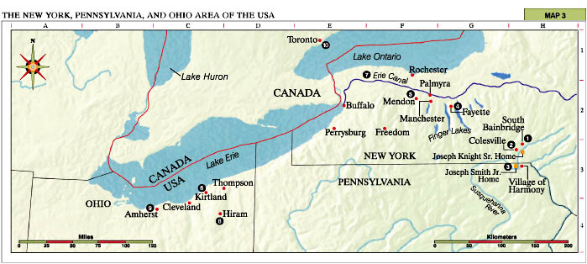

Slide 7
D&C 38: A Call to Covenant
For what was the Lord seeking to prepare the church?
1. The day in which the church found itself (3a)
Finds itself.
2. The coming of the day of the Lord (2b) (Second Coming)
When the veil of darkness is rent.
3. To be aware of the enemy’s plans (2c, 3b)
4. To prepare people for the kingdom of God (2c)
5. Establishing the land of Zion (4)

Slide 8
Genesis 7:73-74
And it came to pass, that Enoch saw the day of the coming of the Son of Man, in the last days, to dwell on the earth, in righteousness, for the space of a thousand years. But before that day, he saw great tribulation among the wicked; and he also saw the sea, that it was troubled, and men's hearts failing them, looking forth with fear for the judgment of the Almighty God, which should come upon the wicked.

Slide 9
D&C 38: A Call to Covenant
How did the Lord work to prepare the church in this revelation?
Gird up your loins.
This is a familiar language in the scriptures.
D&C 26:3d; D&C 34:4b; D&C 35:3b; D&C 36:12g; D&C 43:5c; D&C 61:6d; D&C 73:2b; D&C 75:3h; D&C 103:2; D&C 105:4a, 6a.

Slide 10
Ephesians 6:12-14
For we wrestle not against flesh and blood, but against principalities, against powers, against the rulers of the darkness of this world, against spiritual wickedness in high places. Wherefore take unto you the whole armor of God, that ye may be able to withstand in the evil day, and having done all to stand. Stand therefore, having your loins girt about with truth, and having on the breastplate of righteousness;

Slide 11
1 Nephi 1:121, 124
And after I had smitten off his head with his own sword, I took the garments of Laban and put them upon mine own body; yea, even every whit; and I did gird on his armor about my loins.
And I commanded him in the voice of Laban, that he should go with me into the treasury; and he supposed me to be his master Laban, for he beheld the garments and also the sword girded about my loins.

Slide 12
Alma 21:42
And he fastened on his head-plate, and his breastplate, and his shields, and girded on his armor about his loins; and he took the pole, which had on the end thereof his rent coat (and he called it the title of liberty)

Slide 13
D&C 38: A Call to Covenant
Gird your loins
Is a call to duty.
To awaken to the need to view our calling in spiritual warfare.
To personal responsibility.
wherefore lift up your hearts and rejoice, and gird up your loins, and take upon you my whole armor, that ye may be able to withstand the evil day, having done all ye may be able to stand (D&C 26:3d).

Slide 14
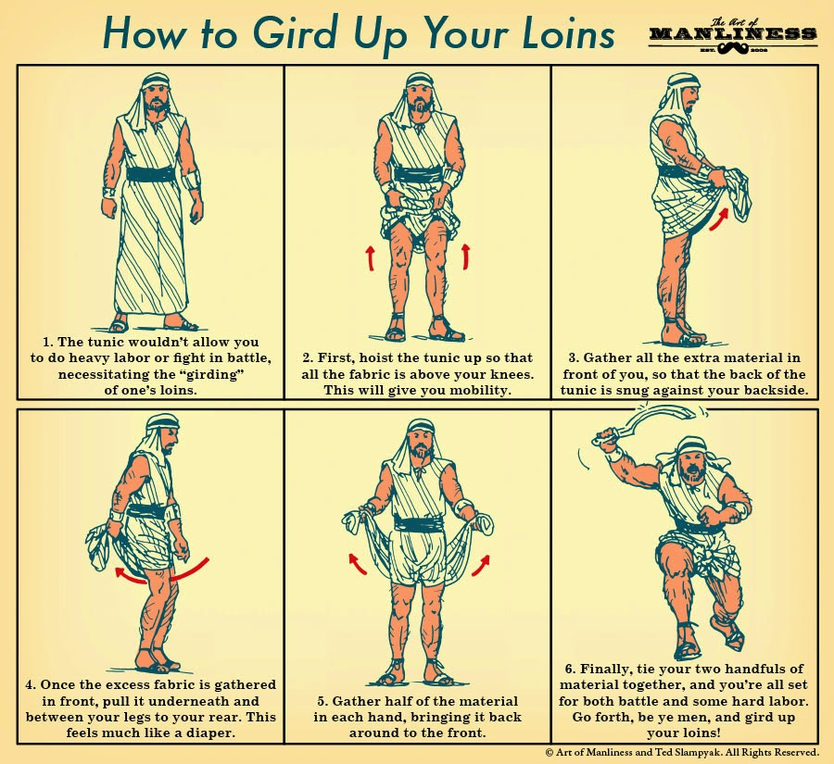

Slide 15
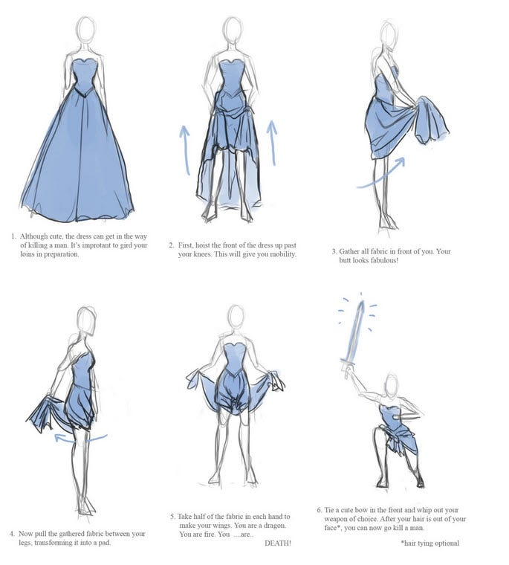

Slide 16
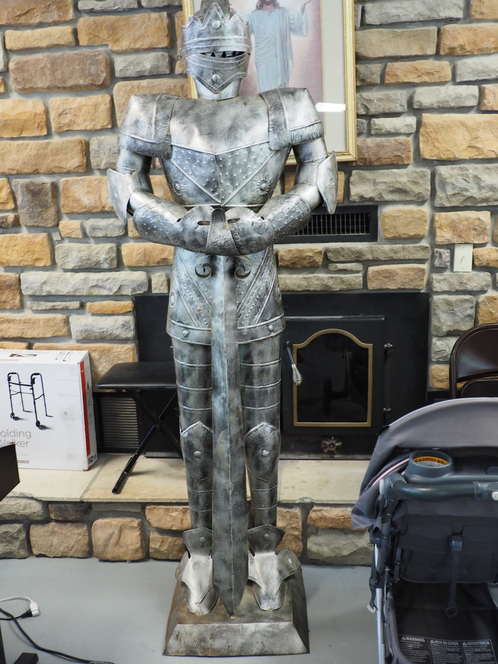

Slide 17
D&C 38: A Call to Covenant
Be Prepared
This is a call to our stewardship and obedience.
On many occasions the Lord commands us to follow his instructions exactly.
Beware concerning yourselves, to give diligent heed to the words of eternal life; for you shall live by every word that proceedeth forth from the mouth of God (D&C 83:7a-b).

Slide 18
Exodus 19:10-11
And the Lord said unto Moses, Go unto the people, and sanctify them today and tomorrow, and let them wash their clothes, And be ready against the third day; for the third day the Lord will come down in the sight of all the people upon mount Sinai.

Slide 19
D&C 38: A Call to Covenant
Raising the awareness of their spiritual situation (2a, 4a).
The Lord tells them he is aware of them and in their midst.
The enemy is aware of you and conspiring for your destruction.
Clean, but not all (3a).
It is a call for repentance.
Not infrequent call to the church in the years to come.

Slide 20
D&C 38: A Call to Covenant
Gave them knowledge of the enemy’s plans (4a).
This is critical intelligence.
Be prepared for difficulty.
The Lord will need to remind and instruct the church on this point more than once.

Slide 21
D&C 50:6b-7c
and that which doth not edify, is not of God, and is darkness: that which is of God is light, and he that receiveth light and continueth in God, receiveth more light, and that light groweth brighter and brighter, until the perfect day. And again, verily I say unto you, and I say it that you may know the truth, that you may chase darkness from among you, for he that is ordained of God and sent forth, the same is appointed to be the greatest, notwithstanding he is least, and the servant of all: wherefore, he is possessor of all things, for all things are subject unto him, both in heaven and on the earth, the life, and the light, the spirit, and the power, sent forth by the will of the Father, through Jesus Christ, his Son;

Slide 22
D&C 50:6b-7c
but no man is possessor of all things, except he be purified and cleansed from all sin; and if ye are purified and cleansed from all sin, ye shall ask whatsoever you will in the name of Jesus, and it shall be done: but know this, it shall be given you what you shall ask, and as ye are appointed to the head, the spirits shall be subject unto you. Wherefore, it shall come to pass, that if you behold a spirit manifested that you can not understand, and you receive not that spirit, ye shall ask of the Father, in the name of Jesus, and if he give not unto you that spirit, that you may know that it is not of God;

Slide 23
D&C 50:6b-7c
and it shall be given unto you power over that spirit, and you shall proclaim against that spirit with a loud voice, that it is not of God; not with railing accusation, that ye be not overcome; neither with boasting, nor rejoicing, lest you be seized therewith:

Slide 24
D&C 22:8a-9c, 13
And now it came to pass, that when Moses had said these words, behold, Satan came tempting him, saying, Moses, son of man, worship me. And it came to pass that Moses looked upon Satan, and said, Who art thou, for behold I am a son of God, in the similitude of his Only Begotten; and where is thy glory, that I should worship thee? For, behold, I could not look upon God except his glory should come upon me, and I were transfigured before him. But I can look upon thee in the natural man. Is it not so surely? Blessed be the name of my God, for his Spirit hath not altogether withdrawn from me; or else where is thy glory, for it is darkness unto me, and I can judge between thee and God;

Slide 25
D&C 22:8a-9c, 13
for God said unto me, Worship God, for him only shalt thou serve. Get thee hence, Satan, deceive me not; for God said unto me, Thou art after the similitude of mine Only Begotten.
…
And it came to pass, that Moses began to fear exceedingly; and as he began to fear, he saw the bitterness of hell; nevertheless, calling upon God he received strength, and he commanded, saying, Depart hence, Satan; for this one God only will I worship, which is the God of glory.

Slide 26
Alma 17:65-67
65 And now my son, remember the words which I have spoken unto you: trust not those secret plans unto this people, but teach them an everlasting hatred against sin and iniquity; 66 Preach unto them repentance, and faith on the Lord Jesus Christ: teach them to humble themselves, and to be meek and lowly in heart; teach them to withstand every temptation of the devil, with their faith on the Lord Jesus Christ; 67 Teach them to never be weary of good works, but to be meek and lowly in heart: for such shall find rest to their souls.

Slide 27
D&C 38: A Call to Covenant
Gave them understanding of heaven’s plans/activities (2b, 3c).
Zion of Enoch safely with God for now (1b).
God is making his voice known in the world (1e, also D&C 1).
The means of judging the inhabitants of the world
John 12:44-50 (the words of Jesus will judge us at the last day).
Angels are waiting for the command to reap down the earth
Because darkness prevails on the earth in the presence of all the hosts of heaven (3b-c).

Slide 28
D&C 38: A Call to Covenant
My eyes are upon you, I am in your midst (2a-b).
This was a common theme in the early revelations.
Where 2 or 3 are gathered together in my name, as touching one thing—there will I be in the midst of them: as I am now with you (D&C 6:15b, also Matthew 18).
I am in your midst and your advocate (D&C 28:2b)

Slide 29
D&C 38: A Call to Covenant
How is the Lord in our midst?
Through his word (his direct voice).
In creation - made by the spoken word of God
In daily grace and sustaining word of God
Scripture
Manna - John 6, Deuteronomy 8:1-3, D&C 83:7a-c
Light and lamp Psalm 119:105
A Feast (2 Nephi 14:4, John 6).

Slide 30
D&C 38: A Call to Covenant
The Lord’s Prayers for Us
D&C 38:2a-b
D&C 45:1c-e
John 17
Gift of the Holy Spirit
John 14:15-21
John 16:7-15

Slide 31
D&C 38: A Call to Covenant
His presence
The same word was made flesh, and dwelt among us (John 1:14).
Alma 5
Mosiah 8
John 20-21 post resurrection
3 Nephi 4-12

Slide 32
Revelation 1:12-16
12 And I turned to see from whence the voice came that spake to me; and, being turned, I saw seven golden candlesticks, 13 And in the midst of the seven candlesticks one like unto the Son of Man, clothed with a garment down to the foot, and girt about the paps with a golden girdle. 14 His head and his hairs were white like wool, as white as snow; and his eyes were as a flame of fire; 15 And his feet like unto fine brass, as if they burned in a furnace; and his voice as the sound of many waters. 16 And he had in his right hand seven stars; and out of his mouth went a sharp two-edged sword; and his countenance was as the sun shining in his strength.

Slide 33
D&C 38: A Call to Covenant
In the covenants of the Father
8a And again, verily I say unto you, that which is governed by law, is also preserved by law, and perfected and sanctified by the same. 8b That which breaketh a law, and abideth not by law, but seeketh to become a law unto itself, and willeth to abide in sin, and altogether abideth in sin, can not be sanctified by law, neither by mercy, justice, or judgment; therefore, they must remain filthy still (D&C 85:8a-b).
The everlasting covenant
The New Covenant

Slide 34
D&C 38: A Call to Covenant
Ordinances of the gospel
3b And this greater priesthood administereth the gospel and holdeth the key of the mysteries of the kingdom, even the key of the knowledge of God. 3c Therefore, in the ordinances thereof the power of godliness is manifest; and without the ordinances thereof, and the authority of the priesthood, the power of godliness is not manifest unto men in the flesh; for without this, no man can see the face of God, even the Father, and live (D&C 83:3b-c).

Slide 35
D&C 38: A Call to Covenant
By design or created in the image of God
Genesis 1:27-29

Slide 36
Exodus 33:13-17
Now therefore, I pray thee, if I have found grace in thy sight, show me now thy way, that I may know thee, that I may find grace in thy sight; and consider that this nation is thy people. And he said, My presence shall go with thee, and I will give thee rest. And he said unto him, If thy presence go not with me, carry us not up hence. For wherein shall it be known here that I and thy people have found grace in thy sight? is it not in that thou goest with us? So shall we be separated, I and thy people, from all the people that are upon the face of the earth. And the Lord said unto Moses, I will do this thing also that thou hast spoken; for thou hast found grace in my sight, and I know thee by name.

Slide 37
D&C 38: A Call to Covenant
He promised to be in the midst of the first missionaries (D&C 31:1c).
D&C 49:5d; D&C 50:8f; 61:6c; 3 Nephi 5:10; 8:13-14; 9:16.
I have heard your prayers (4c).
The poor have complained before me (4c).
More evidence of his imminence and care.
Wherever 2 or 3 are gathered, in my name, touching 1 thing.

Slide 38
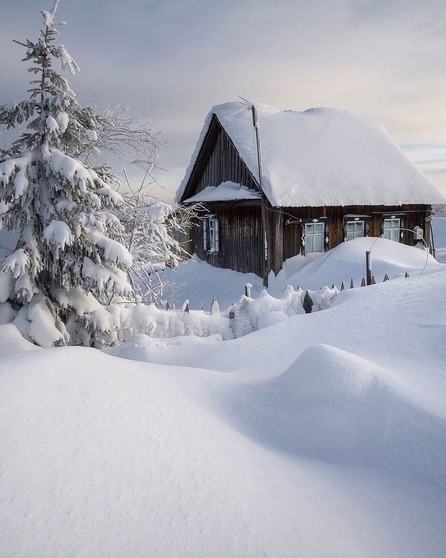

Slide 39
D&C 38: A Call to Covenant
He is our Advocate with the Father (1c).
D&C 28:2b
D&C 31:1c for the first missionary team
D&C 45:1c-e
D&C 62:1a
If any man sin and repent, we have an advocate with the Father, Jesus Christ the righteous (1 John 2:1).

Slide 40
Moroni 7:28
For he hath answered the ends of the law, and he claimeth all those who have faith in him; and they who have faith in him, will cleave unto every good thing; wherefore he advocateth the cause of the children of men; and he dwelleth eternally in the heavens.

Slide 41
D&C 38: A Call to Covenant
Reveals God’s plans for the church (4d-f).
More on this in Lesson 4

Slide 42
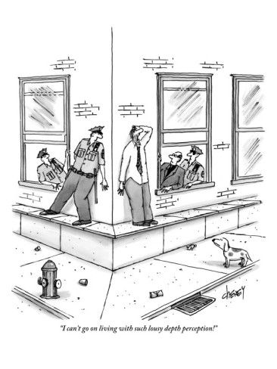
D&C 38: A Call to Covenant
Be strong (4c).
Fear not (4c).
Because the kingdom is yours (4c).
Because of the plans God has for the church.

Slide 43
D&C 38:4 a-c
And now I show unto you a mystery, a thing which is had in secret chambers, to bring to pass even your destruction, in process of time, and ye knew it not, but now I tell it unto you,
and ye are blessed, not because of your iniquity, neither your hearts of unbelief, for verily some of you are guilty before me; but I will be merciful unto your weakness. Therefore, be ye strong from henceforth; fear not for the kingdom is yours: and for your salvation I give unto you a commandment,

Slide 44
D&C 38: A Call to Covenant
Next lesson: How the Lord Purifies the Church

